Slide 1
Deep Learning (III)
楊延齡
hayato655169@gmail.com
8/11/2020

Slide 2

Anaconda3
Notes:
create -c rdkit -n my-rdkit-env意思是在Windows Anaconda3環境裡產生一個名叫my-rdkit-env的環境，因為tensorflow只支援Python3.7，所以在最後還要輸入python=3.7代表在my-rdkit-env環境下是使用python=3.7，接著就可以依序安裝tensorflow跟Keras了!

Slide 3
Installation (GPU version)
1.安裝RDkit
輸入: conda create -c rdkit -n my-rdkit-env rdkit python=3.7
輸入: conda activate my-rdkit-env
2.在my-rdkit-env環境下安裝tensorflow2.0
輸入: conda install tensorflow-gpu=2.0 python=3.7
3.在my-rdkit-env環境下安裝Keras
輸入: conda install Keras
4.在my-rdkit-env環境下安裝scikit-learn
輸入: pip install pillow
輸入: pip install scikit-learn
5.安裝CUDA (下載CUDA 10.0)
https://developer.nvidia.com/cuda-toolkit-archiv
如果你電腦的顯示卡(GPU)不是NVIDIA廠牌或者是N牌顯卡但效能不夠好，請安裝下一頁的CPU版本
Notes:
1.因為RDkit只支援CUDA 10.0，所以到連結下載CUDA 10.0
2.create -c rdkit -n my-rdkit-env意思是在Windows Anaconda3環境裡產生一個名叫my-rdkit-env的環境，因為tensorflow只支援Python3.7，所以在最後還要輸入python=3.7代表在my-rdkit-env環境下是使用python=3.7，接著就可以依序安裝tensorflow跟Keras了!

Slide 4
Installation (CPU version)
1.安裝RDkit
輸入: conda create -c rdkit -n my-rdkit-env rdkit python=3.7
輸入: conda activate my-rdkit-env
2.在my-rdkit-env環境下安裝tensorflow2.0
輸入: conda install tensorflow=2.0 python=3.7
3.在my-rdkit-env環境下安裝Keras
輸入: conda install Keras
4.在my-rdkit-env環境下安裝scikit-learn
輸入: pip install pillow
輸入: pip install scikit-learn
Notes:
create -c rdkit -n my-rdkit-env意思是在Windows Anaconda3環境裡產生一個名叫my-rdkit-env的環境，因為tensorflow只支援Python3.7，所以在最後還要輸入python=3.7代表在my-rdkit-env環境下是使用python=3.7，接著就可以依序安裝tensorflow跟Keras了!

Slide 5

Rdkit Environment
安裝完成後，在選Anaconda3 Navigator出現my-rdkit-env，再接著開啟JupyterLab

Slide 6
Test
1.下載dataset
https://drive.google.com/file/d/1M31pmqrie3EMzj6Y8curOmGrm3pY7Eqf/view?usp=sharing
2.在JupyterLab輸入以下程式碼:
>>> import pandas as pd
>>> df= pd.read_csv('logP_dataset.csv')
>>> df.head()
>>> from rdkit import Chem
>>> df['mol'] = df['smiles'].apply(lambda x: Chem.MolFromSmiles(x))
>>> from rdkit.Chem import Draw
>>> mols = df['mol'][:20]
>>> Draw.MolsToGridImage(mols, molsPerRow=5, useSVG=True, legends=list(df['smiles'][:20].values))

Slide 7
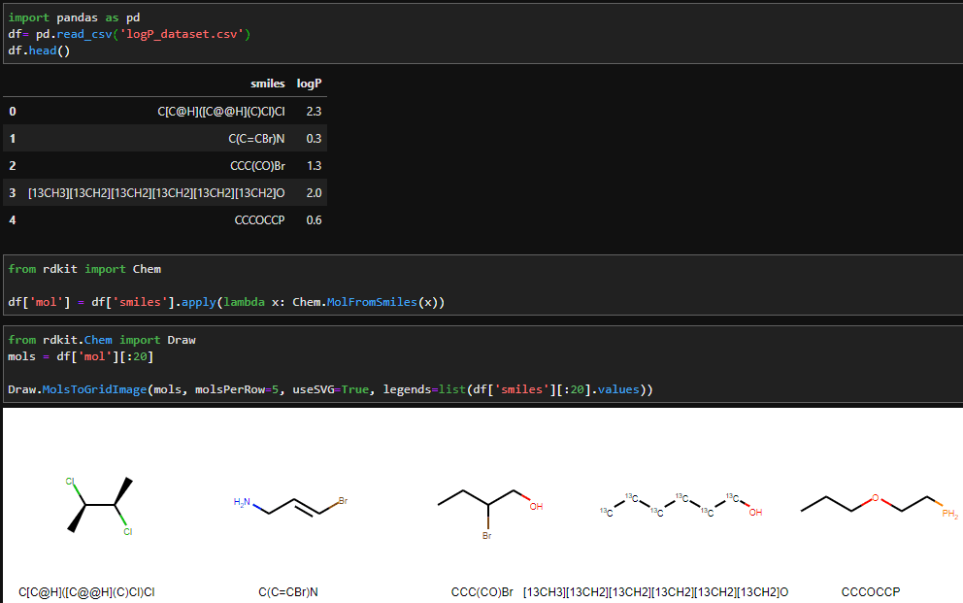
Test

Slide 8
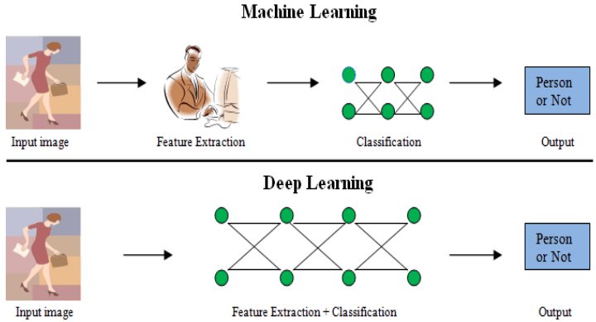
Machine Learning vs. Deep Learning
Traditional Machine Learning approaches done the-feature extraction manually and the classification-algorithm classify the objects
In Deep Learning approaches the network itself extract the features without user interpretation also classify the objects.

Slide 9
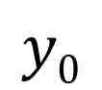
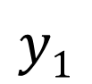
Fully Connected Neural Network
Layer 1
Layer 2
Layer 3
3 layers
Neuron
x₁
$$y0$$
x₂
$$y1$$
x₃
Input Layer
Hidden Layer
Output Layer

Slide 10

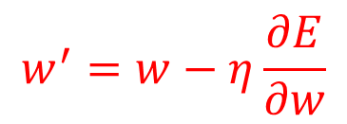

Feedforward and Backpropagation
Layer 1
Layer L-1
Layer L
$$σ$$
$$∑$$
$$w^{′}=w−η\frac{∂E}{∂w}$$
Learning

Slide 11
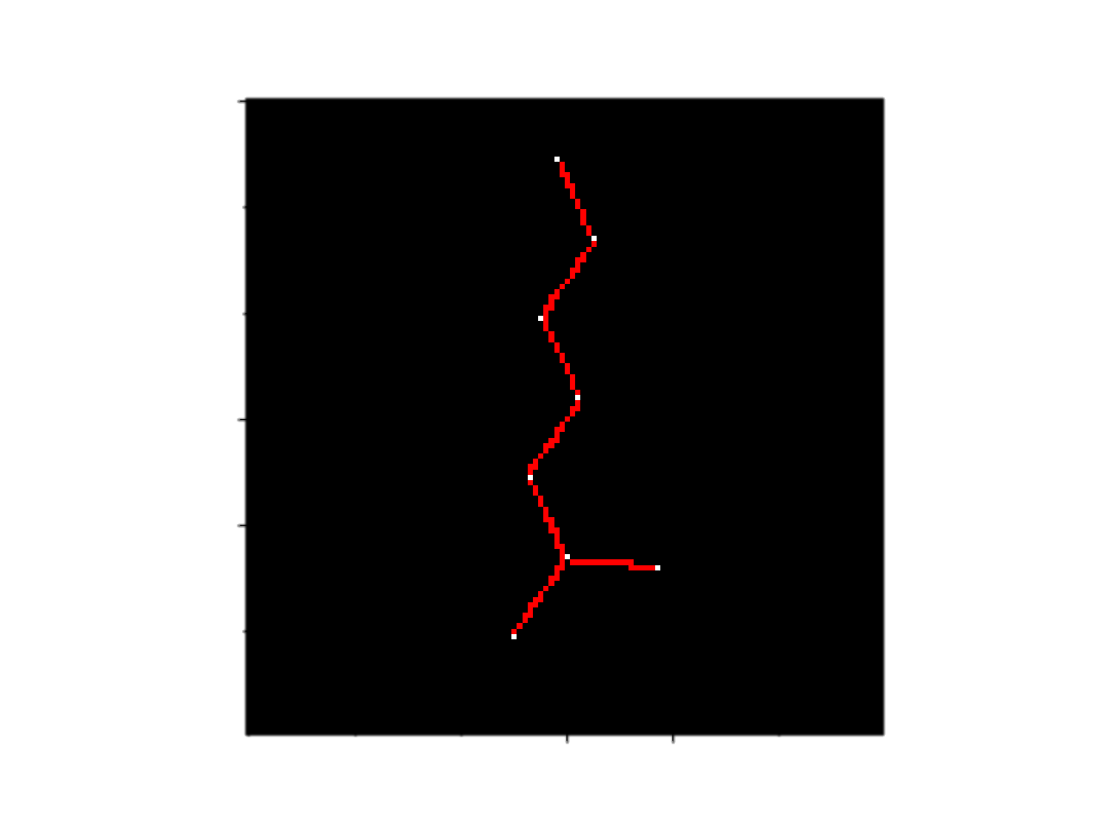
CNN RNN
Convolution Neural Network
Input
Convolution
Pooling
Flatten
Output
深度學習演算法可以直接從影像、文字、與聲音中進行特徵、表現、以及任務的學習，來降低以人工進行特徵選取的需求。
Feature extract from images
Classification or Regression
Recurrent Neural Network
C[C@H]([C@@H](C)Cl)Cl
C(C=CBr)N
CCC(CO)Br
CCCOCCP
C(C(F)(F)F)F
[2H]C([2H])C(C)(C)Cl
Recurrent unit
History/State
Input
Output
Find the relationships between these characters
Classification or Regression

Slide 12
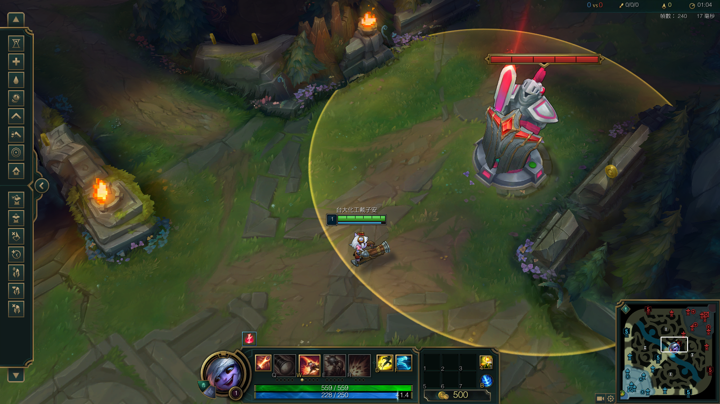
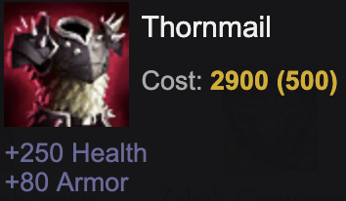
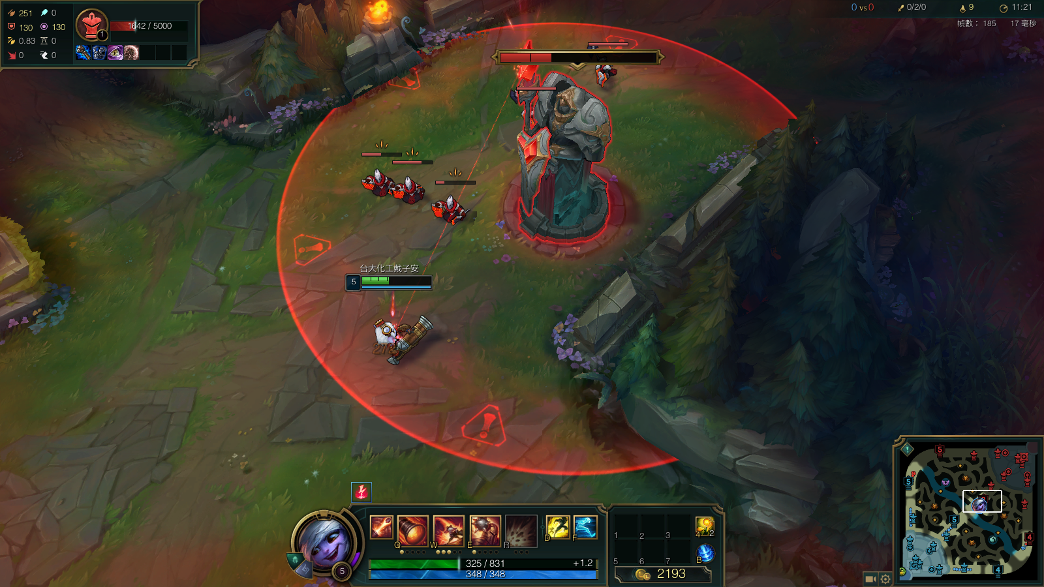
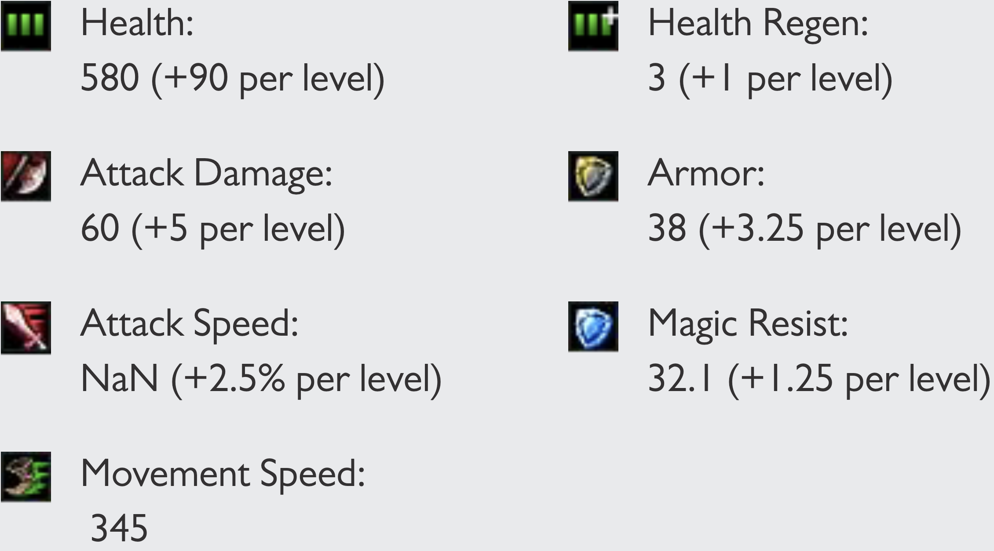
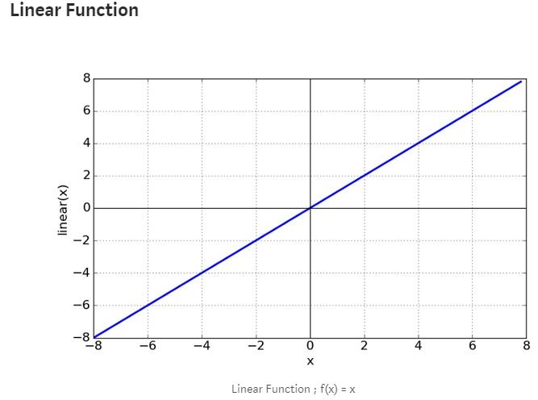

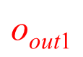
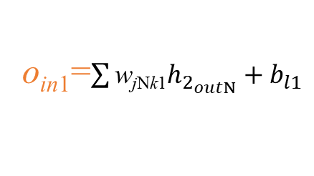
Regression
Lv
Loss=???
𝜎 = Linear function
Turret damage
$$\text{o}\text{out}\text{1}$$
$$\text{o}\text{out}\text{1}=\text{o}\text{in}\text{1}$$
o_{in1}=$\sum{\text{w}\text{j}\text{N}\text{k}\text{1}h_{2_{outN}}}+b_{l1}$

Slide 13
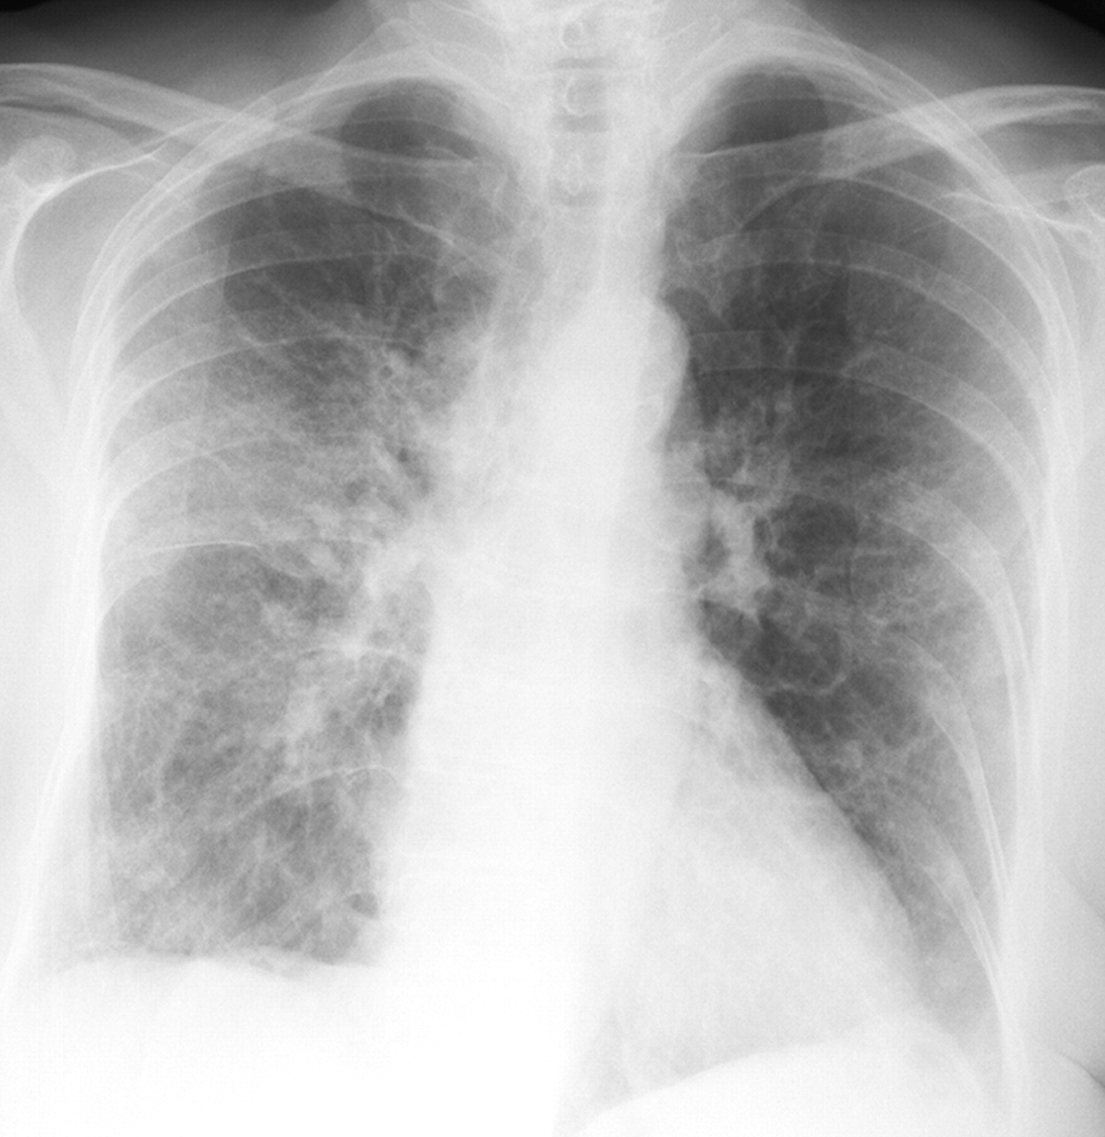
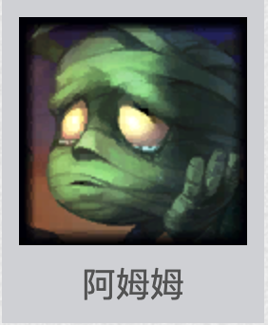
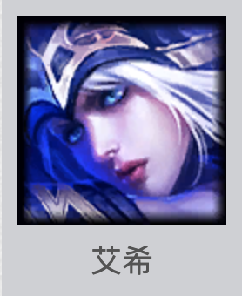
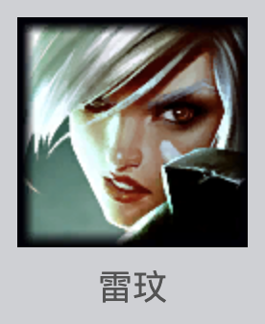
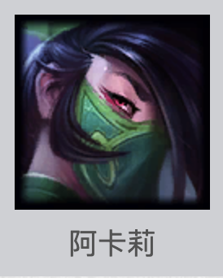


Classification
Binary Classification Problem
- Only one right answer
Categories = 2 | Binary Classification
Positive [1] Negative [0]
Multi-Label Classification Problem
-More than one right answer
-Non-exclusive outputs
Multi-Class Classification Problem
-Only one right answer
-Mutually exclusive outputs
[0]
[1]
Categories = 6 | Multilabel Classification | Multiclass Classification (Single Label)
Assassin [1 0 0 0 0 0] Tank [0 1 0 0 0 0] Mage [0 0 1 0 0 0] Support [0 0 0 1 0 0] Fighter [0 0 0 0 1 0] Marksman [0 0 0 0 0 1]
[0 1 1 0 0 0]
[0 0 0 1 0 1]
[1 0 0 0 1 0]
[1 0 0 0 0 0]
[0 0 1 0 0 0]
[0 0 0 0 0 1]

Slide 14








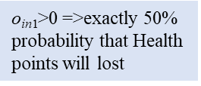
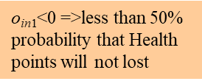
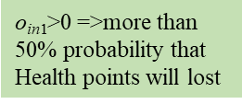
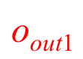
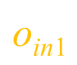
Binary Classification
Health points lost?
Yes
or
Sigmoid
No
$$\text{o}\text{out}\text{1}$$
$\text{o}\text{in}\text{1}\text{>0 =>}$more than 50% probability that Health points will lost
$\text{o}\text{in}\text{1}\text{<}\text{0 =>}$less than 50% probability that Health points will not lost
$\text{o}\text{in}\text{1}\text{>0 =>}$exactly 50% probability that Health points will lost
$$\text{o}\text{in}\text{1}$$

Slide 15
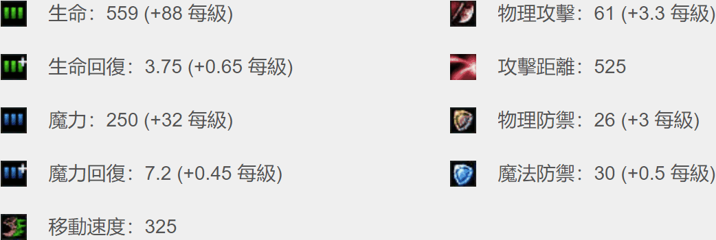

Multilabel Classification Problem
Assassin (0.66)
Tank (0.11)
Mage (0.13)
Support (0.35)
Fighter (0.21)
Marksman (0.79)
Sigmoid

Slide 16
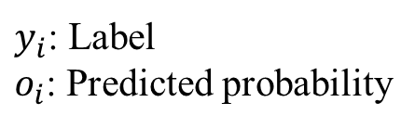
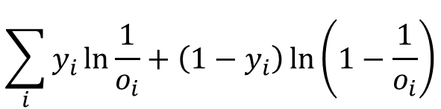
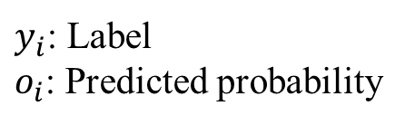
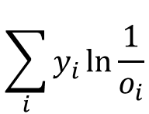
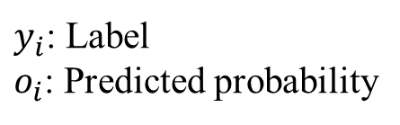
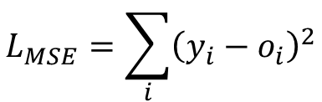
Loss Function
Problem type | Last-layer activation | Loss function (Error)
Binary classification | sigmoid | binary_crossentropy
Multilabel classification | sigmoid | binary_crossentropy
Multiclass classification | softmax | categorical_crossentropy
Regression | none | mse
Binary Cross-entropy
Categorical Cross-entropy
Mean Square Error (MSE)
$$\sum_{i}{y_{i}\ln{\frac{1}{o_{i}}+\left(1−y_{i}\right)\ln\left(1−\frac{1}{o_{i}}\right)}}$$
$$\sum_{i}{y_{i}\ln{\frac{1}{o_{i}}}}$$
$$L_{MSE}=\sum_{i}{{\left(y_{i}−o_{i}\right)}^{2}}$$
$y_{i}$: Label
$o_{i}$: Predicted probability
$y_{i}$: Label
$o_{i}$: Predicted probability
$y_{i}$: Label
$o_{i}$: Predicted probability

Slide 17
Model Evaluation Metrics
Metric: Used to judge the performance of your model. This is only for user to look at and has nothing to do with the optimization process
Regression problems: Mean Absolute Error (MAE), Mean Squared Error (MSE), Root Mean Squared Error (RMSE)
Classification problems: Accuracy, Precision, Recall, F1-score, ROC, AUC, …
Note: The loss function is used to optimize your model. It is designed to be easy to take the derivative and gets minimized by the optimizer.

Slide 18
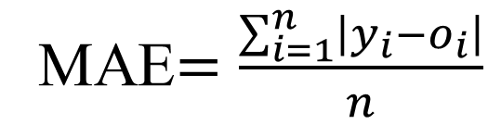
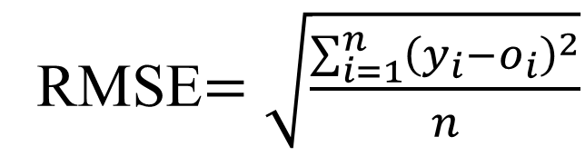
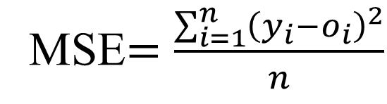
Regression Problems
Mean Absolute Error
(MAE)
Mean Squared Error
(MSE)
Root Mean Squared Error (RMSE)
MAE$=\frac{\sum_{i=1}^{n}{\left|y_{i}−o_{i}\right|}}{n}$
MSE$=\frac{\sum_{i=1}^{n}{{\left(y_{i}−o_{i}\right)}^{2}}}{n}$
RMSE$=\sqrt{\frac{\sum_{i=1}^{n}{{\left(y_{i}−o_{i}\right)}^{2}}}{n}}$

Slide 19
Binary Classification Problems
Confusion matrix: A table that is often used to describe the performance of a classification model
 | True | False
Positive | TP (True Positive) | FP (False Positive)
Negative | FN (False Positive) | TN (True Positive)
TP(True Positive)/真陽性: 檢測結果為陽性，且真的有生病
FP(False Positive)/偽陽性: 檢測結果為陽性，但其實沒有生病
TN(True Negative)/真陰性: 檢測結果為陰性，且真的沒有生病
FN (False Negative)/偽陰性: 檢測結果為陰性，但其實有生病

Slide 20
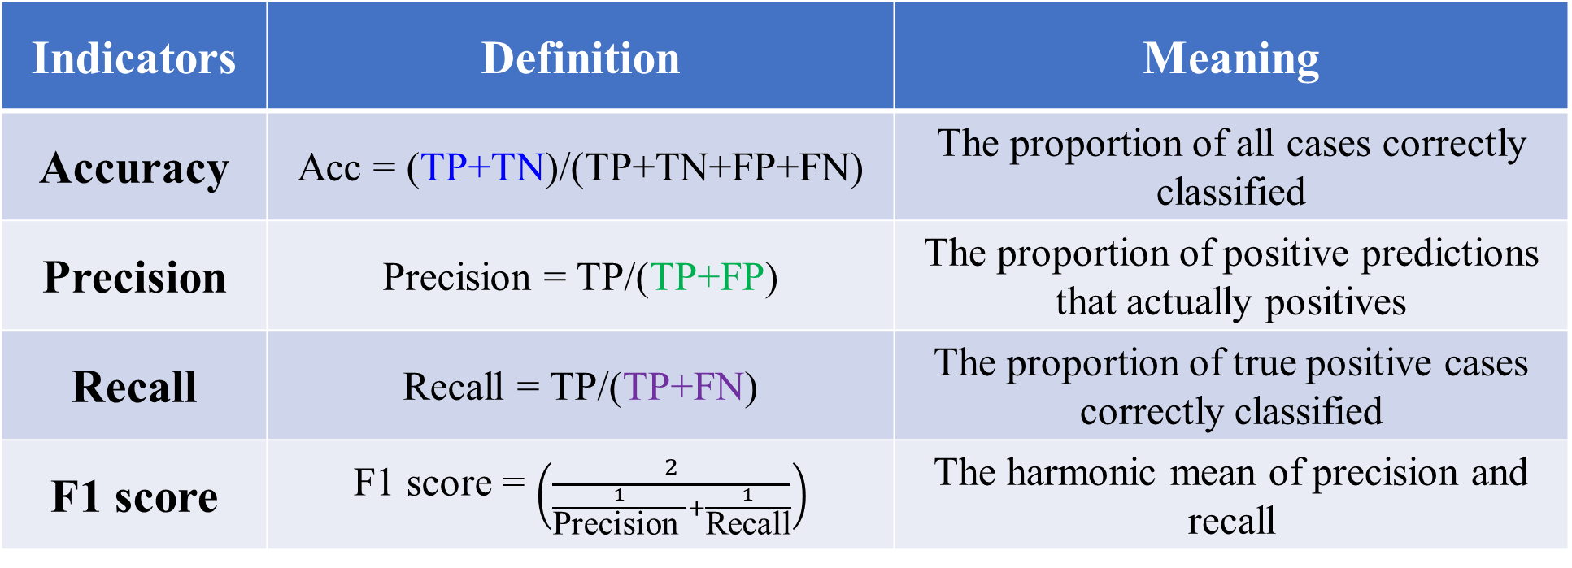
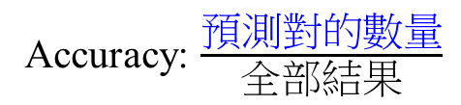
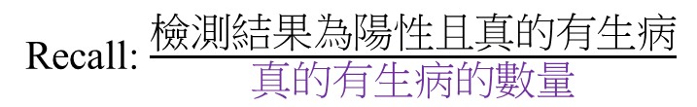
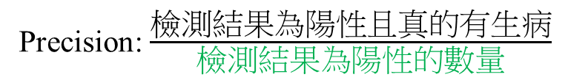
Assessing Predictive Quality
Indicators | Definition | Meaning
Accuracy | Acc = (TP+TN)/(TP+TN+FP+FN) | The proportion of all cases correctly classified
Precision | Precision = TP/(TP+FP) | The proportion of positive predictions that actually positives
Recall | Recall = TP/(TP+FN) | The proportion of true positive cases correctly classified
F1 score | F1 score = $\left(\frac{2}{\frac{1}{\text{Precision} }+\frac{1}{\text{Recall}}}\right)$ | The harmonic mean of precision and recall
TP+TN: 預測對的數量
TP+FP: 檢測結果為陽性的數量
TP+FN: 真的有生病的數量
Accuracy: $\frac{\text{預測對的數量}}{全部\text{結果}}$
Precision: $\frac{\text{檢測結果為陽性且真的有生病}}{\text{檢測結果為陽性的數量}}$
Recall: $\frac{\text{檢測結果為陽性且真的有生病}}{\text{真的有生病的數量}}$

Slide 21
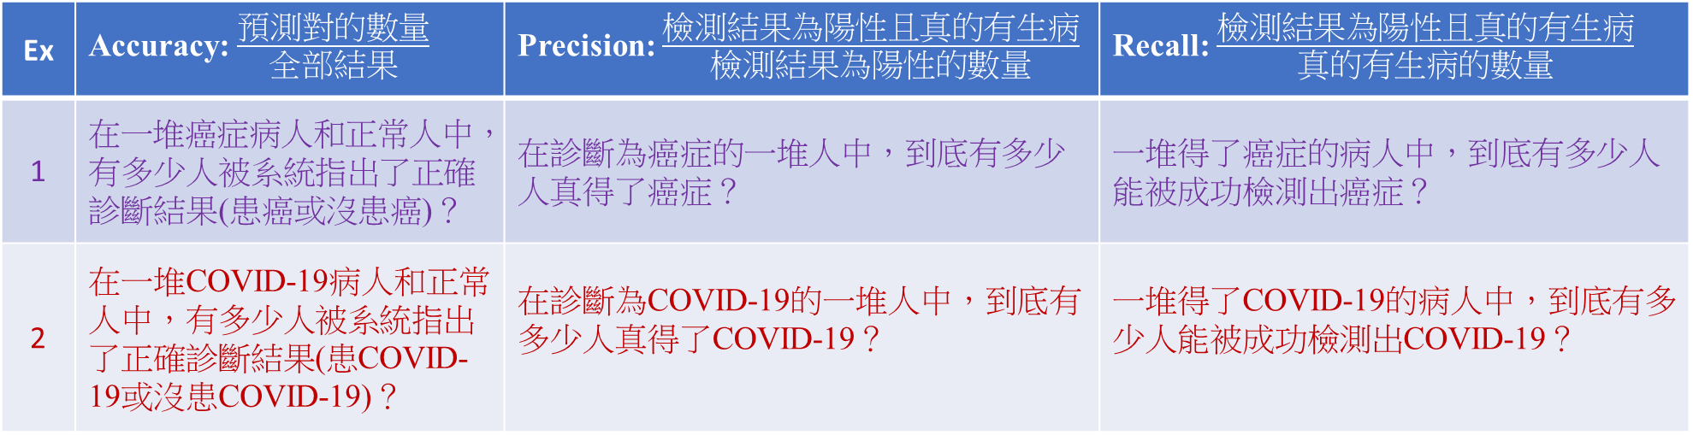
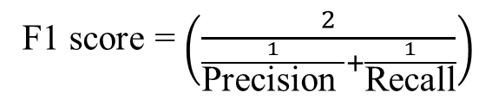
Assessing Predictive Quality
Ex | Accuracy: $\frac{\text{預測對的數量}}{全部\text{結果}}$ | Precision: $\frac{\text{檢測結果為陽性且真的有生病}}{\text{檢測結果為陽性的數量}}$ | Recall: $\frac{\text{檢測結果為陽性且真的有生病}}{\text{真的有生病的數量}}$
1 | 在一堆癌症病人和正常人中，有多少人被系統指出了正確診斷結果(患癌或沒患癌)？ | 在診斷為癌症的一堆人中，到底有多少人真得了癌症？ | 一堆得了癌症的病人中，到底有多少人能被成功檢測出癌症？
2 | 在一堆COVID-19病人和正常人中，有多少人被系統指出了正確診斷結果(患COVID-19或沒患COVID-19)？ | 在診斷為COVID-19的一堆人中，到底有多少人真得了COVID-19？ | 一堆得了COVID-19的病人中，到底有多少人能被成功檢測出COVID-19？
癌症診斷系統的目標是：提高Recall，哪怕犧牲一部分Precision。
COVID-19快篩試劑診斷系統的目標是：提高Precision，哪怕犧牲一部分Recall。
F1 score = $\left(\frac{2}{\frac{1}{\text{Precision} }+\frac{1}{\text{Recall}}}\right)$
綜合了精度和召回的預期的結果。
範圍從0到1的，1代表模型的輸出最好，0代表模型的輸出結果最差。

Slide 22
Multiclass Classification Problems
Confusion Martix |  | True
 |  | Class 1 | Class 2 | Class 3
Prediction | Class 1 | a | b | c
 | Class 1 | d | e | f
 | Class 3 | g | h | i
可以計算『混淆矩陣』(Confusion Matrix)，顯示測試集分類的正確及錯認總和數，左上至右下的對角線為正確數，其他格為錯認數，可以看出某一數字被錯認為哪一數字的機率最高，可以再加強訓練資料，以改善錯誤分類。

Slide 23
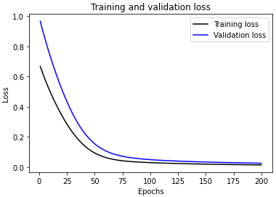
How to Build a Neural Network Model
Cross-Validation
Model
Initial
Dataset
Pre-processed
Dataset
Training
set
Neural Network
Hyperparameter optimization
80%
20%
Trained
Model
x₁ | x₂ | x₃ | y
0.1 | 0.11 | -0.11 | [1,0,0]
0.2 | 0.22 | -0.22 | [0,1,0]
0.3 | 0.33 | -0.33 | [0,0,1]
Test
set
Predicted
y values
Regression
Input
variables
Output
variables
Evaluate
Model
Performance
Mean Square Error
Classification
Accuracy

Slide 24
Data Preparation Process
Data Collection
Data Preprocessing
Data Transformation
(Feature Engineering)
Definition data required
Gathering and combining data from different sources
Formatting
Cleaning
Sampling
Scaling/normalizing
Decomposition
Aggregation

Slide 25
Feature Engineering
Feature Engineering: The process of using domain knowledge to extract features from raw data via data mining techniques
Feature Extraction
Feature Scaling
Categorical Encoding
Feature Selection
Others

Slide 26
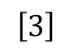
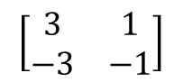
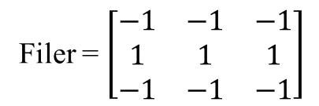
Feature Extraction
Image
Filer = $\left[\begin{matrix}−1 & −1 & −1 \\ 1 & 1 & 1 \\ −1 & −1 & −1\end{matrix}\right]$
$$\left[\begin{matrix}3 & 1 \\ −3 & −1\end{matrix}\right]$$
$$\left[3\right]$$
Convolution
Max pooling

Slide 27
Feature Extraction
Text
- Bag-of-words
- Word embedding

Slide 28
Bag-of-Words
Bag-of-words (BoW): A representation of text that describes the occurrence of words within a document
"John","likes","to","watch","movies","Mary","likes","movies","too"
"Mary","also","likes","to","watch","football","games"
BoW1 = {"John":1,"likes":2,"to":1,"watch":1,"movies":2,"Mary":1,"too":1};
BoW2 = {"Mary":1,"also":1,"likes":1,"to":1,"watch":1,"football":1,"games":1};

Slide 29
Word Embedding
Word Embedding: To map human language into a geometric space
Words
Word Vectors
1
建中
北一女
建中
[0.2,0.8]
雄中
[0.2,0.2]
雄中
雄女
北一女
[0.8,0.8]
0
1
雄女
[0.8,0.2]
The geometric relationships between word vectors should reflect the semantic relationships between these words

Slide 30
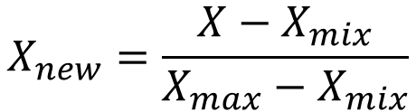
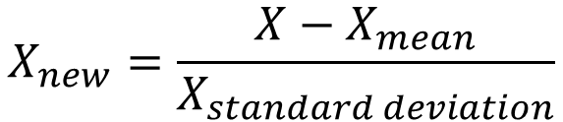
Feature Scaling
Normalization (Min-Max Scaling)
Standardization
(Z-Score Normalization)
$$X_{new}=\frac{X−X_{mix}}{X_{max}−X_{mix}}$$
$$X_{new}=\frac{X−X_{mean}}{X_{standard deviation}}$$
If the data is not scaled, deep learning algorithms that compute the distance between the features are biased towards numerically larger values
Feature scaling helps deep learning algorithms train and converge faster

Slide 31
Normalization and Standardization
Normalization | Standardization
Minimum and maximum value of features are used for scaling | Mean and standard deviation is used for scaling.
It is used when features are of different scales. | It is used when we want to ensure zero mean and unit standard deviation.
Scales values between [0, 1] or [-1, 1]. | It is not bounded to a certain range.
It is really affected by outliers. | It is much less affected by outliers.
Scikit-Learn provides a transformer called MinMaxScaler for Normalization. | Scikit-Learn provides a transformer called StandardScaler for standardization.

Slide 32
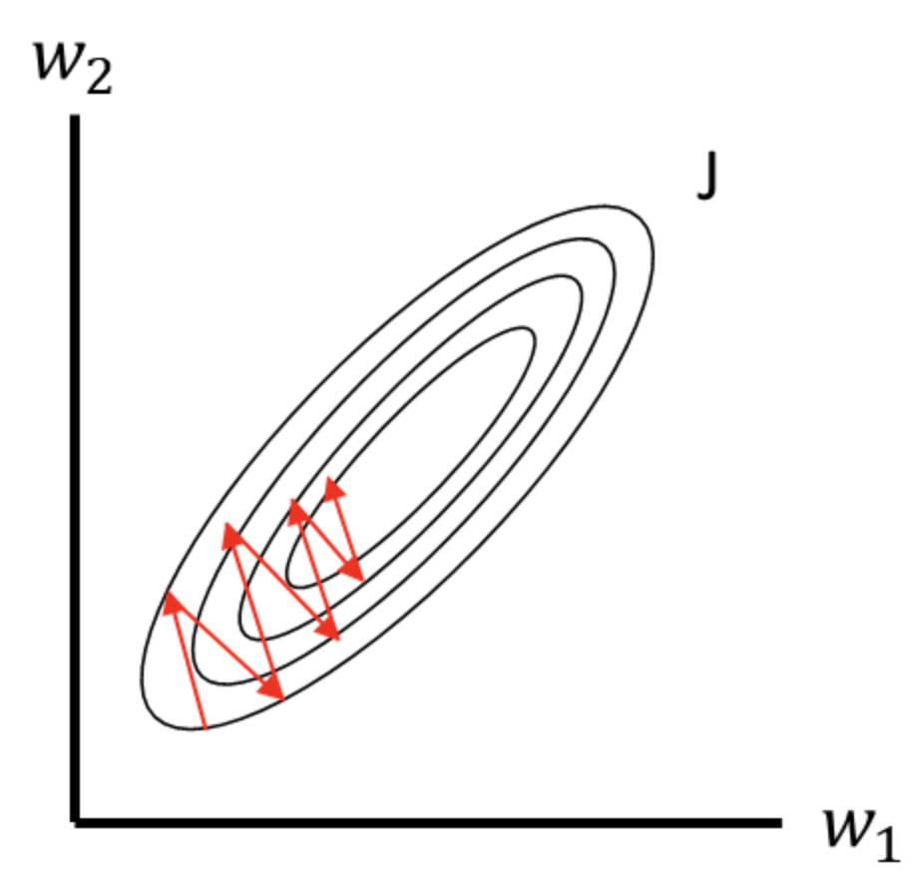

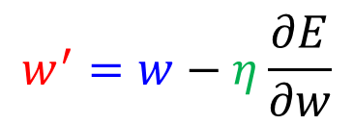
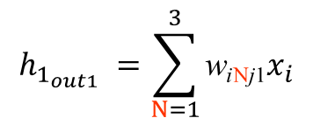
Scale-Sensitive
名稱 | 攻擊距離 | 魔力 | 魔力回復 | 魔力提升 | 生命提升 | 生命 | 生命回復 | 移動速度 | 物理攻擊 | 物理防禦 | 魔法防禦 | 類型
厄薩斯 | 175 | 0 | 0 | 0 | 90 | 580 | 3 | 345 | 60 | 38 | 32.1 | 鬥士
阿璃 | 550 | 418 | 0.8 | 25 | 92 | 526 | 6.5 | 330 | 53 | 20.9 | 30 | 法師
阿卡莉 | 125 | 200 | 0 | 0 | 95 | 575 | 8 | 345 | 62.4 | 23 | 37 | 刺客
亞歷斯塔 | 125 | 350 | 0.8 | 40 | 106 | 573.4 | 8.5 | 330 | 61.1 | 44 | 32.1 | 坦克
阿姆姆 | 125 | 287 | 0.5 | 40 | 84 | 613.1 | 9 | 335 | 53.4 | 33 | 32.1 | 坦克
i₁
j₁
魔力回復
$$h_{1_{out1}} =\sum_{N=1}^{3}{\text{w}\text{i}\text{N}\text{j}\text{1}x_{i}}$$
$$w^{′}=w−η\frac{∂E}{∂w}$$
‘生命’ is more sensitive than ‘魔力回復’
i_{m}
$$\text{j}\text{m}$$
生命
Raw Data

Slide 33
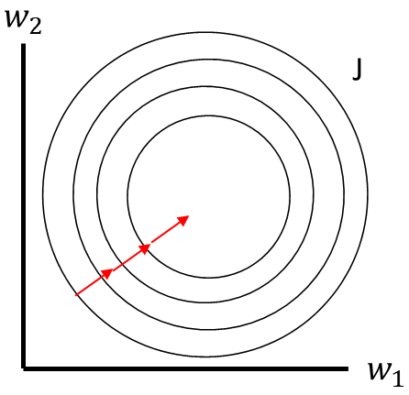
Standardization (Z-Score Normalization)
名稱 | 攻擊距離 | 魔力 | 魔力回復 | 魔力提升 | 生命提升 | 生命 | 生命回復 | 移動速度 | 物理攻擊 | 物理防禦 | 魔法防禦 | 類型
厄薩斯 | -0.770363 | -2.6834 | -2.014848 | -1.986775 | 0.221946 | 0.647642 | -2.02169 | 1.149003 | 0.101302 | 1.182062 | 0.567308 | 鬥士
阿璃 | 1.137805 | 0.938836 | 0.836489 | -0.482882 | 0.522647 | -0.799014 | -0.057272 | -0.834984 | -1.032971 | -1.363209 | -0.662524 | 法師
阿卡莉 | -1.024786 | -0.950273 | -2.014848 | -1.986775 | 0.973699 | 0.513692 | 0.794622 | 1.149003 | 0.490196 | -1.050631 | 3.436917 | 刺客
亞歷斯塔 | -1.024786 | 0.349573 | 0.836489 | 0.419453 | 2.627555 | 0.470828 | 1.065253 | -0.834984 | 0.279545 | 2.075139 | 0.567308 | 坦克
阿姆姆 | -1.024786 | -0.196362 | -0.232762 | 0.419453 | -0.680157 | 1.534389 | 1.345884 | -0.173655 | -0.968156 | 0.437831 | 0.567308 | 坦克
Standardization
Raw Data
Normalized Data

Slide 34
Categorical Encoding
Categorical Encoding: a process of converting categories to numbers
-Integer Encoding (Label Encoding)
-One-hot Encoding

Slide 35
Label Encoding
名稱 | 攻擊距離 | 魔力 | 魔力回復 | 魔力提升 | 生命提升 | 生命 | 生命回復 | 移動速度 | 物理攻擊 | 物理防禦 | 魔法防禦 | 類型
厄薩斯 | 175 | 0 | 0 | 0 | 90 | 580 | 3 | 345 | 60 | 38 | 32.1 | 鬥士
阿璃 | 550 | 418 | 0.8 | 25 | 92 | 526 | 6.5 | 330 | 53 | 20.9 | 30 | 法師
阿卡莉 | 125 | 200 | 0 | 0 | 95 | 575 | 8 | 345 | 62.4 | 23 | 37 | 刺客
亞歷斯塔 | 125 | 350 | 0.8 | 40 | 106 | 573.4 | 8.5 | 330 | 61.1 | 44 | 32.1 | 坦克
阿姆姆 | 125 | 287 | 0.5 | 40 | 84 | 613.1 | 9 | 335 | 53.4 | 33 | 32.1 | 坦克
類型 | Label Encoding
鬥士 | [0]
法師 | [1]
刺客 | [2]
坦克 | [3]

Slide 36
One-Hot Encoding
名稱 | 攻擊距離 | 魔力 | 魔力回復 | 魔力提升 | 生命提升 | 生命 | 生命回復 | 移動速度 | 物理攻擊 | 物理防禦 | 魔法防禦 | 類型
厄薩斯 | 175 | 0 | 0 | 0 | 90 | 580 | 3 | 345 | 60 | 38 | 32.1 | 鬥士
阿璃 | 550 | 418 | 0.8 | 25 | 92 | 526 | 6.5 | 330 | 53 | 20.9 | 30 | 法師
阿卡莉 | 125 | 200 | 0 | 0 | 95 | 575 | 8 | 345 | 62.4 | 23 | 37 | 刺客
亞歷斯塔 | 125 | 350 | 0.8 | 40 | 106 | 573.4 | 8.5 | 330 | 61.1 | 44 | 32.1 | 坦克
阿姆姆 | 125 | 287 | 0.5 | 40 | 84 | 613.1 | 9 | 335 | 53.4 | 33 | 32.1 | 坦克
類型 | One-Hot Encoding
鬥士 | [1 0 0 0]
法師 | [0 1 0 0]
刺客 | [0 0 1 0]
坦克 | [0 0 0 1]

Slide 37
Word Embedding
One-hot word vectors | Word Embeddings
Sparse | Dense
High-dimensional | Lower-dimensional
Hardcoded | Learned from data

Slide 38
Choosing the Right Encoding
Label Encoding | One-Hot Encoding
The categorical feature is ordinal (e.g. age) | The categorical feature is not ordinal (e.g. name)
The number of categories is quite large as one-hot encoding can lead to high memory consumption | The number of categorical features is less so one-hot encoding can be effectively applied
蔡英文=1
韓國瑜=2
宋楚瑜=3
There is a very high probability that the model captures the relationship (蔡英文 is more similar to 韓國瑜 than to 宋楚瑜)

Slide 39
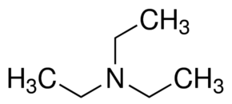



SMILES (簡化分子線性輸入法)
Simplified Mmolecular-Input line-Entry System (SMILES): A specification in the form of a line notation for describing the structure of chemical species using short ASCII strings.
CC
CCN(CC)CC
C1CCCCC1
c1ccccc1

Slide 40

SMILES

Slide 41

Molecular Representation for Machine Learning
Sanchez-Lengeling et al., Science 361, 360–365 (2018)

Slide 42
Model Evaluation Procedures
Train/test split
Classic evaluation
-Simple hold-out validation
-K-fold cross-validation
-Iterated K-fold cross-validation with shuffling)

Slide 43
Training, Validation, and Test Data
Data
x_train
y_train
x_valid
y_valid
x_test
y_test
0.6:0.2:0.2
0.7:0.15:0.15
0.8:0.1:0.1
Model

Slide 44
Why not have training & test sets?
Validation dataset : Tuning a hyperparameter of your model based on the model’s performance (information leaks)
Test dataset: A completely different, never-before-seen dataset

Slide 45
Classic Evaluation
Simple hold-out validation
K-fold cross-Validation
Iterated K-fold cross-validation with shuffling

Slide 46
Simple Hold-Out Validation
Total available labeled data
Training set
Validation Set
Train on this
Evaluate on this
If different random shuffling rounds of the data before splitting end up yielding very different measures of model performance

Slide 47
K-Fold Cross-Validation
Dataset
Splits into K parts
D1 | D2 | D3 | D4
Training Set
Validation Set
Fold 1
D1 | D2 | D3
D4
Evaluation 1
Fold 2
D1 | D2 | D4
D3
Evaluation 2
Average
Fold 3
D1 | D3 | D4
D2
Evaluation 3
Fold 4
D2 | D3 | D4
D1
Evaluation 4

Slide 48




Python Library for Building Neural Networks

Slide 49
Process
Input X
Layer
Layer
Predictions
Y’
True targets
Y
Loss function
Weights
Weight update
Optimization
Loss score

Slide 50
Regression in Keras
1. Define Network
model = Sequential()
model.add(Dense(96, input_dim=6, activation='relu'))
model.add(Dense(96, activation='relu'))
model.add(Dense(1))
2. Compile Network
model.compile(loss="mse", optimizer="adam", metrics=["mae"])
3. Fix Network
history = model.fit(X_train, y_train, epochs=500, batch_size=256, validation_split=0.1)
4. Evaluate Network
loss, accuracy = model.evaluate(X_test, y_test)
5. Make Predictions
predictions = model.predict(X_test)

Slide 51
Binary Classification in Keras
1. Define Network
model = Sequential()
model.add(Dense(96, input_dim=6, activation='relu'))
model.add(Dense(96, activation='relu'))
model.add(Dense(1))
2. Compile Network
model.compile(loss="binary_crossentropy", optimizer="adam", metrics=["accuracy"])
3. Fix Network
history = model.fit(X_train, y_train, epochs=500, batch_size=256, validation_split=0.1)
4. Evaluate Network
loss, accuracy = model.evaluate(X_test, y_test)
5. Make Predictions
predictions = model.predict(X_test)

Slide 52
Multiclass Classification in Keras
1. Define Network
model = Sequential()
model.add(Dense(96, input_dim=6, activation='relu'))
model.add(Dense(96, activation='relu'))
model.add(Dense(1))
2. Compile Network
model.compile(loss="categoricalcrossentropy", optimizer="adam", metrics=["accuracy"])
3. Fix Network
history = model.fit(X_train, y_train, epochs=500, batch_size=256, validation_split=0.1)
4. Evaluate Network
loss, accuracy = model.evaluate(X_test, y_test)
5. Make Predictions
predictions = model.predict(X_test)

Slide 53
Epoch
1 epoch
step
batch_size
batch_size
batch_size
Data

Slide 54


Effect of Batch Size on Neural Net Training
Theory says that, bigger the batch size, lesser is the noise in the gradients and so better is the gradient estimate. This allows the model to take a better step towards a minima. However, the challenge is that bigger batch size needs more memory and each step is time consuming.
$$Loss function=\frac{1}{batch_size}\sum_{i}{y_{i}\ln{\frac{1}{o_{i}}}}$$
$$Loss function=\frac{1}{batch_size}\sum_{i}{{\left(y_{i}−o_{i}\right)}^{2}}$$
Keeping the batch size small makes the gradient estimate noisy which might allow us to bypass a local optimum during convergence. But having very small batch size would be too noisy for the model to convergence anywhere.
In general smaller or larger batch size doesn't guarantee better convergence. Batch size is more or less treated as a hyperparameter to tune keeping in the memory constraints you have.

Slide 55


Example 1
名稱 | 攻擊距離 | 魔力 | 魔力回復 | 魔力提升 | 生命提升 | 生命 | 生命回復 | 移動速度 | 物理攻擊 | 物理防禦 | 魔法防禦 | 類型
厄薩斯 | 175 | 0 | 0 | 0 | 90 | 580 | 3 | 345 | 60 | 38 | 32.1 | 鬥士
阿璃 | 550 | 418 | 0.8 | 25 | 92 | 526 | 6.5 | 330 | 53 | 20.9 | 30 | 法師
阿卡莉 | 125 | 200 | 0 | 0 | 95 | 575 | 8 | 345 | 62.4 | 23 | 37 | 刺客
亞歷斯塔 | 125 | 350 | 0.8 | 40 | 106 | 573.4 | 8.5 | 330 | 61.1 | 44 | 32.1 | 坦克
阿姆姆 | 125 | 287 | 0.5 | 40 | 84 | 613.1 | 9 | 335 | 53.4 | 33 | 32.1 | 坦克
攻擊距離
i₁
j₁
魔力
k₁
鬥士
魔力回復
147 data
11 feature
6 output classes
Multiclass classification
法師
魔力提升
生命提升
刺客
Input
生命
Predict
生命回復
坦克
移動速度
$$\text{k}\text{m}$$
射手
物理攻擊
物理防禦
i_{m}
$$\text{j}\text{m}$$
輔助
魔法防禦

Slide 56


Read Excel
>>> import pandas as pd
>>> df = pd.read_excel('LOL.xlsx')
>>> df.head()
>>> Label = df['類型'].values
>>> X_train = df.drop(columns=['名稱','類型’])

Slide 57


From Label Encoding to One-Hot Encoding
>>> for i in range(Label.shape[0]):
>>> if Label[i] == '鬥士':
>>> Label[i] = 0
>>> elif Label[i] == '法師':
>>> Label[i] = 1
>>> elif Label[i] == '刺客':
>>> Label[i] = 2
>>> elif Label[i] == '坦克':
>>> Label[i] = 3
>>> elif Label[i] == '射手':
>>> Label[i] = 4
>>> elif Label[i] == '輔助':
>>> Label[i] = 5
>>> from keras.utils.np_utils import to_categorical
>>> y_train = to_categorical(Label)

Slide 58
Standardization and Building a Neural Network
>>> mean = X_train.mean(axis=0)
>>> std = X_train.std(axis=0)
>>> X_train = (X_train - mean) / std
>>> from keras.models import Sequential
>>> from keras.layers import Dense
>>> model = Sequential()
>>> model.add(Dense(100, input_dim=11, activation='relu'))
>>> model.add(Dense(6, activation='softmax'))
>>> model.compile(loss="categorical_crossentropy", optimizer="adam", metrics=["accuracy"])
>>> history = model.fit(X_train, y_train, epochs=2000, batch_size=128, validation_split=0.4)

Slide 59
history_dict.keys()
>>> import matplotlib.pyplot as plt
>>> history_dict = history.history
>>> print(history_dict.keys())
Version 1: dict_keys(['val_loss', 'val_acc', 'loss', 'acc’])
Version 2: dict_keys(['val_loss', 'val_accuracy', 'loss', 'accuracy'])
>>> loss_values = history_dict['acc']
>>> val_loss_values = history_dict['val_acc']
>>> #loss_values = history_dict['accuracy']
>>> #val_loss_values = history_dict['val_accuracy']

Slide 60

Plotting Training and Validation Loss
>>> epochs = range(1, len(loss_values) + 1)
>>> plt.plot(epochs, loss_values, 'b', color='k', label='Training accuracy')
>>> plt.plot(epochs, val_loss_values, 'b', color='b', label='Validation accuracy')
>>> plt.title('Training and validation accuracy')
>>> plt.xlabel('Epochs')
>>> plt.ylabel('Accuracy')
>>> plt.legend()
>>> plt.show()
Overfitting!!!

Slide 61


Feature Selection
Selection: Choosing a subset of the original pool of features
Feature只選攻擊距離跟魔力、Label只選鬥士、法師跟射手 (147 data, 11 feature, 3 output classes)

Slide 62

Read Excel
>>> import pandas as pd
>>> df = pd.read_excel('LOL.xlsx')
>>> df.head()
>>> df = df[(df['類型'].isin(['鬥士','法師','射手']))]
>>> Label = df['類型'].values
>>> X_train = df.drop(columns=['名稱','魔力回復','魔力提升','生命提升','生命','生命回復',
'移動速度','物理攻擊','物理防禦','魔法防禦','類型'])

Slide 63

From Label Encoding to One-Hot Encoding
>>> for i in range(Label.shape[0]):
>>> if Label[i] == '鬥士':
>>> Label[i] = 0
>>> elif Label[i] == '法師':
>>> Label[i] = 1
>>> elif Label[i] == '射手':
>>> Label[i] = 2
>>> from keras.utils.np_utils import to_categorical
>>> y_train = to_categorical(Label)

Slide 64
Standardization and Building a Neural Network
>>> mean = X_train.mean(axis=0)
>>> std = X_train.std(axis=0)
>>> X_train = (X_train - mean) / std
>>> from keras.models import Sequential
>>> from keras.layers import Dense
>>> model = Sequential()
>>> model.add(Dense(100, input_dim=2, activation='relu'))
>>> model.add(Dense(3, activation='softmax'))
>>> model.compile(loss="categorical_crossentropy", optimizer="adam", metrics=["accuracy"])
>>> history = model.fit(X_train, y_train, epochs=2000, batch_size=128, validation_split=0.4)

Slide 65
history_dict.keys()
>>> import matplotlib.pyplot as plt
>>> history_dict = history.history
>>> print(history_dict.keys())
Version 1: dict_keys(['val_loss', 'val_acc', 'loss', 'acc’])
Version 2: dict_keys(['val_loss', 'val_accuracy', 'loss', 'accuracy'])
>>> loss_values = history_dict['acc']
>>> val_loss_values = history_dict['val_acc']
>>> #loss_values = history_dict['accuracy']
>>> #val_loss_values = history_dict['val_accuracy']

Slide 66

Plotting Training and Validation Loss
>>> epochs = range(1, len(loss_values) + 1)
>>> plt.plot(epochs, loss_values, 'b', color='k', label='Training accuracy')
>>> plt.plot(epochs, val_loss_values, 'b', color='b', label='Validation accuracy')
>>> plt.title('Training and validation accuracy')
>>> plt.xlabel('Epochs')
>>> plt.ylabel('Accuracy')
>>> plt.legend()
>>> plt.show()

Slide 67
Sufficiently Large Intermediate Layers
Final outputs are 6-dimensional, you should avoid intermediate layers with many fewer than 6 hidden units.
The network is able to cram most of the necessary information into the small dimensional representations, but not all of it.

Slide 68

Further Experiments
取消Standardization或改用Min-Max Scaling
改變batch_size大小
增加神經元或層數
隱藏層神經元小於輸出層神經元
改變optimizer，例如RMSProp或下面的SGD
>>> from keras import optimizers
>>> sgd = optimizers.SGD(lr=0.01) #也可以順便改變learning rate
>>> model.compile(loss="categorical_crossentropy", optimizer=sgd, metrics=["accuracy"])
Feature改成"攻擊距離"跟"魔力回復"
$$X_{new}=\frac{X−X_{mix}}{X_{max}−X_{mix}}$$

Slide 69
Shallow Neural Network
Shallow Neural Network (SNN): One input and one output layer, and at most one hidden layer in between
Deep Neural Networks (DNN): More than one hidden layer of activation functions.
Shallow neural networks also suffer from the problem of overfitting [1,2], although probably not as much as deep learning.
[1] G. Geman, E. Bienenstock, R. Doursat, Neural networks and the bias/variance dilemma. Neural Comput., 4 (1992), pp. 1-58
[2] S. Haykin, Neural Networks. A Comprehensive Foundation. Macmillan College Publishing Co., New York, USA (1999)

Slide 70
Shallow vs. Deep
Shallow Neural Network | Deep Neural Network
More efficient to train | Challenging to train
Simpler structural decision | Sophisticated structural decision
The idea of having more layers is to extract more finer features of the input vector . So generally as we increase the depth of the model we increase the power of the model at the cost of the computational complexity .

Slide 71
Visualizing what convnets learn
First convolution layer
Second convolution layer

Slide 72
Visualizing what convnets learn
Third convolution layer

Slide 73
Visualizing what convnets learn
Forth convolution layer

Slide 74

Non-convex Optimization Problem
Loss function for deep neural networks is highly non-convex and includes many local minima, plateaus and saddle points.
Theory and experiments suggest that for high dimensional deep models, value of loss function at most local minima is close to value of loss function at global minimum. [ref]
Most local minima are good local minima!
Loss
local minima
w
Loss
w_{j}
saddle points
Loss
plateaus
w
w_{i}

Slide 75


Learning Rate and Weight Initialization
Training deep neural networks with tens of layers is challenging as they can be sensitive to the initial random weights and configuration of the learning algorithm.
Weight Initialization Method
Pre-training
Random initialization
Xavier initialization
He initialization
$$w^{′}=w−η\frac{∂E}{∂w}$$
w_{initial}
Loss
𝜂
Regularization
L1, L2
Dropout
Others
Optimization Algorithm
RMSprop
Adam
Others
$$w^{′}$$
w

Slide 76
Pre-training
Auto-encoder

Slide 77
Random Initialization
Activation function: tanh
Normal distribution
Vanishing gradient

Slide 78
Xavier Initialization
nᵢ: The number of incoming network connections (fan-in)
nᵢ₊₁:The number of outgoing network connections from that layer (fan-out)
Good for tanh!!!
Maintaining near identical variances of its weight gradients across layers

Slide 79
He Initialization
Xavier (Glorot) Initialization isn’t quite as optimal for ReLU functions
Solve
Only one tiny adjustment of Xavier (Glorot) Initialization, which is to multiply the variance of the weights by 2!

Slide 80

Different Activation Functions

Slide 81

Underfitting and Overfitting
Underfitting
Overfitting
Solving:
Reducing the network’s size
Adding weight regularization
Adding dropout (0.2-0.5)
Batch Normalization

Slide 82




L2 Regularization
$$Loss function=E+\frac{α}{2}\sum_{i=1}^{n\left[l−1\right]}{\sum_{j=1}^{n\left[l\right]}{{\left(w_{ij}^{\left[l\right]}\right)}^{2}}}$$
$${\left\|w^{\left[l\right]}\right\|}^{2}=\sum_{i=1}^{n\left[l−1\right]}{\sum_{j=1}^{n\left[l\right]}{{\left(w_{ij}^{\left[l\right]}\right)}^{2}}}:$$
Frobenius Norm
α: weight decay
Target
$$w^{′}=w−η\frac{∂E}{∂w}−α\sum_{i=1}^{n\left[l−1\right]}{\sum_{j=1}^{n\left[l\right]}{w_{ij}^{\left[l\right]}}}$$
Data

Slide 83
Dropout Regularization
Prohibit the neurons from relying only on certain features,
and therefore the weights are spread out

Slide 84





















Batch Normalization
Input
$$h_{1}$$
$$σ$$
$$h_{2}$$
Output
$$j_{1}^{I}=\frac{j_{1}−μ}{σ}$$
i₁
j₁
$$j_{1}^{′}$$
$$j_{1}^{II}=j_{1}^{I} γ+β$$
k₁
l₁
$$σ$$
$$j_{2}^{I}=\frac{j_{2}−μ}{σ}$$
$$j_{2}^{II}=j_{2}^{I} γ+β$$
i₂
$$\text{j}\text{2}$$
$$j_{2}^{′}$$
k₂
l₂
$$σ$$
$$j_{3}^{I}=\frac{j_{3}−μ}{σ}$$
$$j_{3}^{II}=j_{3}^{I} γ+β$$
i₃
$$\text{j}\text{3}$$
$$j_{3}^{′}$$
k₃
l₃
$$∑$$
Sigmoid
or
tanh
Softmax
$$μ=\frac{1}{3}\sum_{i=1}^{3}{j_{i}}$$
$$σ=\sqrt{\frac{1}{3}\sum_{i=1}^{3}{{\left(j_{i}−μ\right)}^{2}}}$$
不希望進去activation function的資料 mean 都是 0，標準差都是 1
$$γ,β$$

Slide 85
Advantages of Batch Normalization
Reduces internal covariant shift
Reduces the dependence of gradients on the scale of the parameters or their initial values
Regularizes the model and reduces the need for dropout, photometric distortions, local response normalization and other regularization techniques
Allows use of saturating nonlinearities and higher learning rates

Slide 86
Example 2
SMILES | logP
C[C@H]([C@@H](C)Cl)Cl | 2.3
C(C=CBr)N | 0.3
CCC(CO)Br | 1.3
[13CH3][13CH2][13CH2][13CH2][13CH2][13CH2]O | 2.0
CCCOCCP | 0.6
Partition coefficient (P): The ratio of concentrations of a compound in a mixture of two immiscible solvents at equilibrium. (e.g. water and octanol)
Chemical insights: From theory P value must turn great when a molecule is large and doesn't have many polar atoms or atomic groups (such containing O, N, P, S, Br, Cl, F an etc.) in it.
Ref: https://www.kaggle.com/vladislavkisin/tutorial-ml-in-chemistry-research-rdkit-mol2vec/data

Slide 87

Example 2-1
Num of atoms | Num of heavy atoms | Num of C atoms | Num of O atoms | Num of N atoms | Num of Cl atoms | logP
14 | 6 | 4 | 0 | 0 | 2 | 2.3
11 | 5 | 3 | 0 | 1 | 0 | 0.3
15 | 6 | 4 | 1 | 0 | 0 | 1.3
21 | 7 | 6 | 1 | 0 | 0 | 2.0
20 | 7 | 5 | 1 | 0 | 0 | 0.6
Num of atoms
Num of heavy atoms
Num of C atoms
Num of O atoms
Num of N atoms
Num of Cl atoms
i₁
j₁
14610 data
6 feature
1 output classes
Regression
Input
k₁
logP
i_{m}
$$\text{j}\text{m}$$

Slide 88
Read Excel and Count the Number of Atoms
>>> import pandas as pd
>>> df= pd.read_csv('logP_dataset.csv')
>>> df.head()
>>> from rdkit import Chem
>>> df['mol'] = df['smiles'].apply(lambda x: Chem.MolFromSmiles(x)) #SMILE轉成Mol格式
>>> df['mol'] = df['mol'].apply(lambda x: Chem.AddHs(x)) #將H原子添加到Mol
>>> df['num_of_atoms'] = df['mol'].apply(lambda x: x.GetNumAtoms()) #原子的數量
>>> df['num_of_heavy_atoms'] = df['mol'].apply(lambda x: x.GetNumHeavyAtoms()) #返回重原子數目（原子序> 1）
>>> X_train = df.drop(columns=['名稱','類型’])

Slide 89

Plotting the Number of Atom and log P
>>> import seaborn as sns
>>> sns.jointplot(df.num_of_atoms, df.logP)
>>> plt.show()
Information is not enough!!!

Slide 90
From Label Encoding to One-Hot Encoding
>>> def number_of_atoms(atom_list, df):
>>> for i in atom_list:
>>> df['num_of_{}_atoms'.format(i)] = df['mol'].apply(lambda x:len(x.GetSubstructMatches(Chem.MolFromSmiles(i))))
>>> number_of_atoms(['C','O', 'N', 'Cl'], df)
Return a tuple of tuples of positions of corresponding patterns.
To extract the number of matches we need to take the length of a corresponding tuple of tuples

Slide 91

Plotting the Number of Atom and log P
>>> sns.pairplot(df[['num_of_atoms','num_of_C_atoms','num_of_N_atoms', 'num_of_O_atoms', 'logP']], diag_kind='kde', kind='reg', markers='+')
>>> plt.show()

Slide 92
Splitting Data and Standardization
>>> train_df = df.drop(columns=['smiles', 'mol', 'logP'])
>>> y = df['logP'].values
>>> mean = train_df .mean(axis=0)
>>> std = train_df .std(axis=0)
>>> train_df = (train_df - mean) / std
>>> from sklearn.model_selection import train_test_split
>>> X_train, X_test, y_train, y_test = train_test_split(train_df , y, test_size=.1, random_state=1)

Slide 93
Building a Neural Network
>>> from keras.models import Sequential
>>> from keras.layers import Dense
>>> model = Sequential()
>>> model.add(Dense(96, input_dim=6, activation='relu'))
>>> model.add(Dense(96, activation= 'relu'))
>>> model.add(Dense(1))
>>> model.summary()
>>> model.compile(loss="mse", optimizer="adam", metrics=["mae"])
>>> history = model.fit(X_train, y_train, epochs=500, batch_size=256, validation_split=0.1)

Slide 94
history_dict.keys()
>>> import matplotlib.pyplot as plt
>>> history_dict = history.history
>>> print(history_dict.keys())
Version 1: dict_keys(['val_loss', 'val_acc', 'loss', 'acc’])
Version 2: dict_keys(['val_loss', 'val_accuracy', 'loss', 'accuracy'])
>>> loss_values = history_dict['acc']
>>> val_loss_values = history_dict['val_acc']
>>> #loss_values = history_dict['accuracy']
>>> #val_loss_values = history_dict['val_accuracy']

Slide 95

Plotting Training and Validation Loss
>>> epochs = range(1, len(loss_values) + 1)
>>> plt.plot(epochs, loss_values, 'b', color='k', label='Training accuracy')
>>> plt.plot(epochs, val_loss_values, 'b', color='b', label='Validation accuracy')
>>> plt.title('Training and validation accuracy')
>>> plt.xlabel('Epochs')
>>> plt.ylabel('Accuracy')
>>> plt.legend()
>>> plt.show()
Overfitting!!!

Slide 96
Building a Neural Network with Dropout
>>> from keras.models import Sequential
>>> from keras.layers import Dense
>>> model = Sequential()
>>> model.add(Dense(96, input_dim=6, activation='relu'))
>>> model.add(Dropout(0.5))
>>> model.add(Dense(96, activation= 'relu'))
>>> model.add(Dropout(0.5))
>>> model.add(Dense(1))
>>> model.summary()
>>> model.compile(loss="mse", optimizer="adam", metrics=["mae"])
>>> history = model.fit(X_train, y_train, epochs=500, batch_size=256, validation_split=0.1)

Slide 97

Plotting Training and Validation Loss
>>> epochs = range(1, len(loss_values) + 1)
>>> plt.plot(epochs, loss_values, 'b', color='k', label='Training accuracy')
>>> plt.plot(epochs, val_loss_values, 'b', color='b', label='Validation accuracy')
>>> plt.title('Training and validation accuracy')
>>> plt.xlabel('Epochs')
>>> plt.ylabel('Accuracy')
>>> plt.legend()
>>> plt.show()
Perfect!!!

Slide 98


Validation Higher than Training Accurracy
This happens after you use Dropout => Underfitting (high bias )
Reason: When training, a proportion of the features are set to zero (50% in your case since you're using Dropout(0.5)). When testing, all features are used (and are scaled appropriately). So the model at test time is additional robust - and might cause higher testing accuracies.
Solution:
-Try a little bit bigger network
-Try a different Deep Neural Network Architectures
-Train for a longer time
-Try using advanced optimization algorithms

Slide 99
Accuracy and Predict
Accuracy
>>> results = model.evaluate(X_test, y_test)
[0.379343104129944, 0.46965262293815613]
loss value
metrics values
Predict
>>> predictions = model.predict(X_test)

Slide 100
Further Experiments
測試一組shallow跟deep 參數量都一樣
取消Standardization或改用Min-Max Scaling
改變batch_size和epoch大小
增加神經元或層數
使用Batch Normalization
做He Initialization
>>> from tensorflow.keras import initializers
>>> initializers.he_normal(seed=None)
改變optimizer，例如RMSProp或下面的SGD
>>> from keras import optimizers
>>> sgd = optimizers.SGD(lr=0.01) #也可以順便改變learning rate
>>> model.compile(loss="categorical_crossentropy", optimizer=sgd, metrics=["accuracy"])

Slide 101

Example 2-2
SMILES | logP
C[C@H]([C@@H](C)Cl)Cl | 2.3
C(C=CBr)N | 0.3
CCC(CO)Br | 1.3
[13CH3][13CH2][13CH2][13CH2][13CH2][13CH2]O | 2.0
CCCOCCP | 0.6
C
(
C
=
C
B
r
)
N
i₁
j₁
14610 data
6 feature
1 output classes
Regression
Input
k₁
logP
i_{m}
$$\text{j}\text{m}$$

Slide 102
Dividing the SMILES into Unique Tokens
>>> from keras.preprocessing import text, sequence
>>> from keras.preprocessing.text import Tokenizer
>>> tokenizer = Tokenizer(lower=False, char_level=True)
>>> tokenizer.fit_on_texts(df.values[:,0])
>>> X = tokenizer.texts_to_sequences(df.values[:,0])
>>> X = sequence.pad_sequences(X, dtype='int32', truncating='pre', value=0., maxlen=max_length)
>>> print("word_index =", tokenizer.word_index)

Slide 103
Building a Neural Network
Tokens
Word Embedding
LSTM

Slide 104

Plotting Training and Validation Loss
>>> epochs = range(1, len(loss_values) + 1)
>>> plt.plot(epochs, loss_values, 'b', color='k', label='Training loss')
>>> plt.plot(epochs, val_loss_values, 'b', color='b', label='Validation loss')
>>> plt.title('Training and validation loss')
>>> plt.xlabel('Epochs')
>>> plt.ylabel('Loss')
>>> plt.legend()
>>> plt.show()
Perfect!!!

Slide 105
Further Experiments
改變batch_size和epoch大小
增加神經元或層數
做Xavier Initialization
>>> from tensorflow.keras import initializers
>>> initializers.GlorotNormal(seed=None)
改變optimizer，例如RMSProp或下面的SGD
>>> from keras import optimizers
>>> sgd = optimizers.SGD(lr=0.01) #也可以順便改變learning rate
>>> model.compile(loss="categorical_crossentropy", optimizer=sgd, metrics=["accuracy"])
使用Batch Normalization
用SimpleRNN或GRU
將Br和Cl各自表示成一個token

